Slide 1

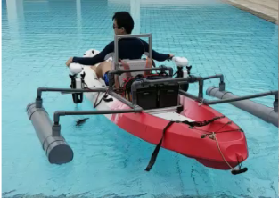
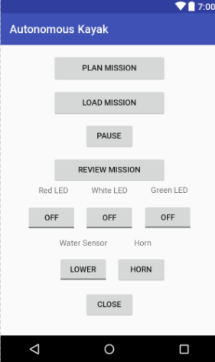
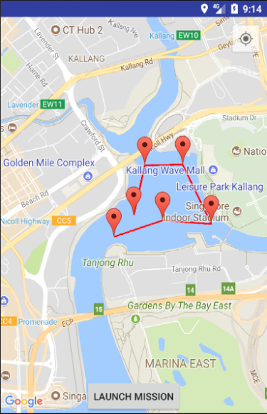
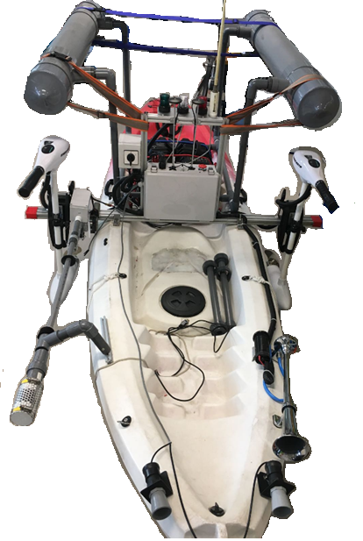
Autonomous Kayak
Introduction
The Autonomous Kayak was build as a cheaper and a more convenient alternative to replace the solar powered boat as it can be easily pushed and brought out of the water without using a crane to do thorough maintenance.
Objective
The main objective is to implement autonomous control into the system so that it can navigate on its own to the waypoints set, lower the water sensors into the water, read and store the water data.
Autonomous Kayak
Autonomous features:
Ability to travel to waypoints set
Able to lower sensors into the water through the app
Choice of number of samples and each interval
Properly store data collected
Warn near-by water users using horn and LED
Able to steer clear of obstacles
Able to return to home/start position
Main Layout
Map Layout
Android App:
Front View
Immediately opens up map at kallang river
Click to place marker and edit water sensor data for each waypoint
Draws a polyline between each waypoint for better user interface experience
Press and hold to clear waypoints
Stabilizers
WIFI
Module
LED
Lights
GPS
Modules
Batteries
Trolling
Motors
Application:
The Autonomous Kayak has 3 modes of operation: manual, remote, and autonomous. The manual mode allows the user to sit on the kayak and steer it. The remote mode allows the kayak to be controlled remotely. The autonomous mode allows the kayak to be controlled via the android application.
Water
sensors
Horn
Ultrasonic sensors
Quek Kai Jie Nicholas
Ryan Goh Rui En
Mr Chew Jee Loong
Mr Lim Yew Kin
17AMC02
Mr Terrence Ler Bee Leng
Mr Tan Chee Hwa Eric

